Slide 1
PROLOG
The name “PROLOG” originates from “Programming in Logic”
Generally speaking, Logic Programming is a computational formalism which combines two central principles:
It uses logic to express knowledge (to represent assumptions and conclusions);
It uses inference to manipulate knowledge (establish the logical connections between assumptions and conclusions)

Slide 2
Prolog – key points (1)
A Prolog program is often called a database or a knowledge base.
A Prolog program consists of one or more valid clauses. Each clause terminates with a full stop.
A Prolog program can be extended by simply adding new clauses.
Prolog clauses are of three types: facts, rules and questions (or inquiries, or goals).
By means of questions the user can ask/query the Prolog system what things are (true).

Slide 3
Prolog – key points (2)
A Prolog clause consists of the head and the body. The body is a list of conditions separated by commas/semi-commas. Commas stand for conjunctions (i.e., “AND”), and semi-commas stand for disjunctions (i.e., “OR”).
Facts are clauses without conditions (i.e., the body is empty). Rules have the head and the (non-empty) body. Questions only have the body.
See examples on following slides.

Slide 4
Prolog – key points (3)
Fact(s):
The Smith family lives in a wood frame house.
lives_in(wood_frame_house, smith).
Rule(s):
If X is a dog and X has short hair then X is funny.
funny(X) :-
dog(X),
has_short_hair(X).

Slide 5
Prolog – key points (4)
Questions:
Does Frank live in a wood frame house?
?- lives_in(wood_frame_house, frank).
Who lives in a wood frame house?
?- lives_in(wood_frame_house, X).
How would Long Tail be described?
(Or Is Long Tail funny?)
?- funny(long_tail).

Slide 6
Prolog – key points (5)
In Prolog, knowledge takes the form of predicates, which may or may not have accompanying arguments.
Predicated must begin with a lower-case alpha character and precede their argument.
Arguments must be enclosed within round brackets. When more than one argument is required, they must be separated by commas.
N.B. Syntactically, all data objects in Prolog are called terms.

Slide 7
Prolog Data Objects (1)
  Prolog Data Types
  variables nonvariables
  atomics nonatomics
  lists general structure or terms
  atoms integers strings database floating-point
  reference numbers
  numbers

Slide 8
Prolog Data Objects (2)
Variables
A variable name can be any alphanumeric characters that begin with a Capital letter or an underscore (_), or it can be a single underscore (_) to represent an anonymous variable. E.g.,
Balloon, X, _, _0039
A variable may be become instantiated to any other term. In addition, variables may be unified with other variables - when one variable becomes instantiated, all the other occurrences of the same variable also become instantiated to the same term.
N.B. If two terms unify with each other, we may also say they match.

Slide 9
Prolog Data Objects (3)
Atoms
Atoms are textual constants. They may contain letters, digits, or symbols. If they begin with an upper-case letter, or a digit, they must be enclosed in single quotes. E.g.,
tennis, ’23’, ’Paris’
--->, ::=, ’Mary’’s’
Atoms always unify with atoms of the same name. Atoms can be up to 255 characters long.

Slide 10
Prolog Data Objects (4)
Integers
Integers are positive and negative whole numbers with a range between -2147483648 and 2147483647 (a 32-bit signed integer). E.g.:
3 , 299, 23456, -899, 0
Integers always unify with integers of the same value.
ASCII characters are also integers. The integer ASCII value of a character is that character prefaced by a single back-quote character (’). E.g., ’a and 97 are equivalent.

Slide 11
Prolog Data Objects (5)
Strings
Strings are textual constants that are used to efficiently manipulate text. They are written as ASCII characters enclosed in dollar signs ($). E.g.,
$He
climbed
and he climbed$
$The boy paid $$5 for the toy.$
An empty string is written as $$.
Strings unify with strings having the identical text. Strings and atoms never unify, even they have the identical text.

Slide 12
Prolog Data Objects (6)
Database reference numbers
Database reference numbers serve as reference points for the database. Everything stored in the database is assigned its own unique database reference number. These numbers are displayed as tilde (~) followed by eight hexadecimal digits. E.g.:
~00255515, ~00035D18
Database reference numbers always unify with themselves.

Slide 13
Prolog Data Objects (7)
Floating-point numbers
Floating-point numbers allow Prolog to perform arithmetic on fractions. Floating-point numbers have 15 decimal places of accuracy.
The format is: an optional sign followed by at least one digit followed by a decimal point followed by at least one digit optionally followed by the exponent. The exponent is in the form E (or e) followed by an optional sign followed by an integer in the range -308 to 308. E.g.:
0.5, 55.3, -83.0E21, 122.345e25
Floating-point numbers unify with other floating-point numbers. However, be aware floating-point operations are inexact and attempting to unify two seemingly identical numbers may not succeed.

Slide 14
Prolog Data Objects (8)
Lists
A list is a sequence of elements ranked in a significant order. Any Prolog term (e.g., variables, structures, or other lists) may all be elements in a list. In list notation, each element of the list is separated by a comma, and the entire set of elements is placed insides square brackets. E.g.:
[a, b, c], [a, X, [a, b]], [] (i.e., empty list)
A list consists of a head and a tail. The head of the list is the first element in the list. The tail of the list is all the remaining elements in the list. The vertical bar (|) can be used to separate the head from the tail. E.g., the list [a,b,c,d] can be represented as:
[a|[b,c,d]]
Lists unify with other lists if the elements of the lists unify.

Slide 15
Prolog Data Objects (9)
Structures
A structure is composed of the functor and its arguments. Each functor is defined by two things:
    The name, whose syntax is that of atoms;
    The arity - that is, the number of arguments.
Structures unify with other structures if the functors match and all their corresponding arguments unify. E.g.:
book(Author, Title)
book(james, $The lonely tree$)
match.
name(jones, charles)
name(jones, chunk)
don’t match.

Slide 16
SWI Prolog (1)
Starting SWI-Prolog:
Click the Start button at the bottom of the window, then
Programs/SWI Prolog/SWI-Prolog-Editor. You will see the following:

Slide 17
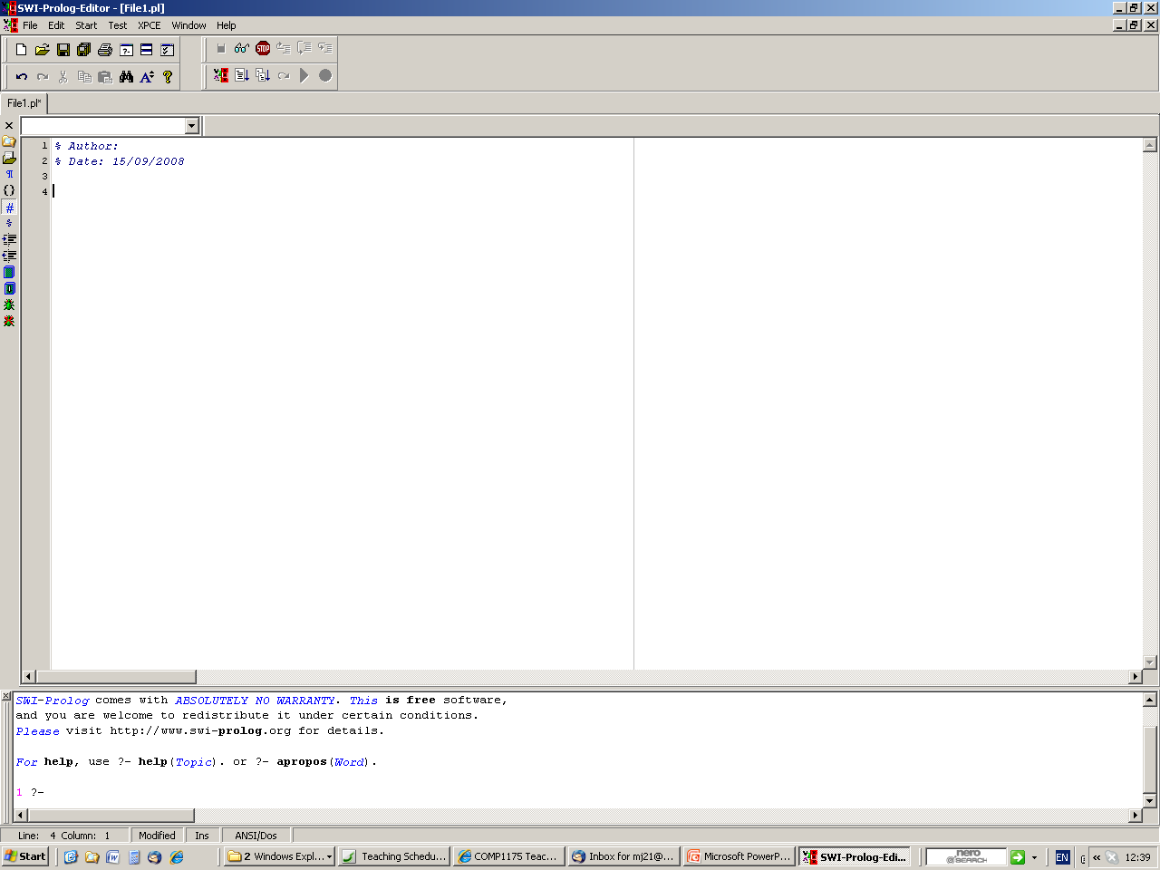
SWI Prolog (2)

Slide 18
LPA Prolog (3)
You can open an existing Prolog program by clicking the File menu button, then selecting Open...
OR
Create/edit a new Prolog program by clicking the File menu, and then selecting New. E.g., in the editor window, type in:
child(X) :- boy(X); girl(X).
boy(john).
boy(robert).
boy(tony).
girl(rose).
girl(pat).
Save it as child.pl

Slide 19
SWI Prolog (4)
To compile an opened program, click the Start menu, and then select Compile.
At the Console window, is the Top Level of SWI-Prolog:
?-
which is the symbol for beginning a query, or namely the goal(s).
?- chile(rose).
Correct to: "child(rose)"? no
ERROR: '$execute_goal2'/2: Undefined procedure: chile/1
ERROR: However, there are definitions for:
ERROR: child/1
?- child(rose).
true.
?- child(mary).
fail.

Slide 20
SWI Prolog (5)
Don’t forget the full stop symbol “.” At
the end of the query.
To get more solutions/answers, press “;”
?- child(Children).
Children = john ;
Children = robert ;
Children = tony ;
Children = rose ;
Children = pat
?-

Slide 21
SWI Prolog – Example 1.1
Example 1.1
Given the Program database as:
a(X) :- b(X, Y), c(Y).
a(X) :- c(X).
b(1, 2).
b(2,2).
b(3,3).
b(3,4).
c(2).
c(5).
What will be the results for the following goals, respectively?
1. a(1)
2. a(2)
3. a(3)
4. a(4)

Slide 22
SWI Prolog - Example 1.2
A standard format for the goal a(5):
Subgoals | Comment | Result
a(5) | uses 1st clause | new subgoals
b(5, Y) | tries 1st clause | fails
b(5, Y) | tries 2nd clause | fails
b(5, Y) | tries 3rd clause | fails
a(5) | using 1st clause | fails
a(5) | uses 2nd clause | new subgoal
c(5) | tries 1st clause | fails
c(5) | tries 2nd clause | succeeds
a(5) | using 2nd clause | succeeds
Compile the program and then test the result:
?- a(5).
yes

Slide 23
SWI Prolog - Example 1.3
Subgoals | Comment | Result
a(1) | uses 1st clause | new subgoals
b(1, Y) | uses 1st clause | succeeds with Y=2
c(2) | uses 1st clause | succeeds
a(1) | using 1st clause | succeeds
Compile the program and then test the result:
?- a(1).
yes
The goal is solved in a very straightforward way. There is no backtracking.

Slide 24
SWI Prolog - Example 1.4
Subgoals | Comment | Result
a(2) | uses 1st clause | new subgoals
b(2, Y) | uses 1st clause | fails
b(2, Y) | uses 2nd clause | succeeds with Y=2
c(2) | uses 1st clause | succeeds
a(2) | using 1st clause | succeeds
Compile the program and then test the result:
?- a(2).
yes
Here, we have s simple case where a failure forces the use of the second half of the definition for b/2.

Slide 25
SWI Prolog - Example 1.5
Subgoals | Comment | Result
a(3) | uses 1st clause | new subgoals
b(3, Y) | tries 1st clause | fails
b(3, Y) | tries 2nd clause | fails
b(3, Y) | tries 3rd clause | succeeds with Y=3
c(3) | tries 1st clause | fails
c(3) | tries 2nd clause | fails
b(3,Y) | tries 4th clause | succeeds with Y=4
c(4) | tries 1st clause | fails
c(4) | tries 2nd clause | fails
b(3,Y) | no more clauses | fails
a(3) | uses 2nd clause | new subgoal
c(3) | tries 1st clause | fails
c(3) | tries 2nd clause | fails
a(3) | no more clauses | fails

Slide 26
SWI Prolog - Example 1.6
Compile the program and then test the result:
?- a(3).
No
This is much harder because in trying to solve b(3,Y), c(Y) we have the first subgoal succeed then the second fail twice over before running out of options. We then backtrack to try the remaining option for solving the top level goal which is the subgoal c(3) but this also fails.

Slide 27
SWI Prolog - Example 1.7
Subgoals | Comment | Result
a(4) | uses 1st clause | new subgoals
b(4, Y) | tries 1st clause | fails
b(4, Y) | tries 2nd clause | fails
b(4, Y) | tries 3rd clause | fails
b(4, Y) | using 4th clause | fails
a(4) | uses 2nd clause | new subgoal
c(4) | tries 1st clause | fails
c(4) | tries 2nd clause | fails
a(4) | no more clauses | fails
Compile the program and then test the result:
?- a(4).
no
It is a little simpler because no subgoal succeeds at all.

